Slide 1

Analysis of U.S. Federal Spending Patterns and the Impact of Omnibus Bills on National Debt
Exploring Blockchain and Big Data for Transparency in Fiscal Oversight Justan E. Dunn
Colorado State University Global MIS581-1: Capstone - Business Intelligence and Data Analytics
Professor Jamia Mills
11/03/2024
Notes:
Hello everyone, my name is Justan Dunn, and today I’ll be presenting my capstone project titled 'Analysis of U.S. Federal Spending Patterns and the Impact of Omnibus Bills on National Debt.' This research explores how modern technologies like blockchain and big data could enhance transparency in government spending. Let's dive into the details.

Slide 2
Introduction
Problem: Rising U.S. national debt, reaching $35.35 trillion in 2024
Purpose: Examine Omnibus bill influence and propose oversight solutions
Significance: Promotes fiscal transparency and accountability
Notes:
The United States faces an escalating national debt problem, now exceeding $35 trillion. Much of this debt is driven by Omnibus bills, large spending packages that reduce transparency and make it challenging to scrutinize individual expenditures. My research investigates how this spending structure contributes to debt growth and considers the potential of civilian oversight supported by blockchain and big data for promoting transparency and accountability in federal budgeting.

Slide 3
Dataset Description
FRED Database: Historical trends on debt, expenditures, and surplus/deficit
USAspending.gov: Transaction-level data on federal spending Combining high-level trends with detailed transactional data
Notes:
Two main data sources were utilized in this project: the Federal Reserve Economic Data (FRED) database for high-level trends and USAspending.gov, which provided transaction-level spending insights. Together, these datasets allow for a comprehensive analysis of how different spending bills impact federal debt.

Slide 4
Hypotheses
Null Hypothesis (H0): No relationship between Omnibus bills and debt growth
Alternative Hypothesis (H1): Omnibus bill usage correlates with debt growth
Notes:
The study revolves around two hypotheses. The null hypothesis states that Omnibus bills have no significant impact on debt growth, while the alternative hypothesis suggests that they do. By testing these hypotheses, I aim to determine if there’s a quantifiable link between Omnibus bills and debt accumulation, which could then justify the need for increased transparency and oversight.

Slide 5
Methodology
Data cleaning, fiscal year alignment, Omnibus year designation Statistical tests: T-Tests, Mann-Whitney U, ANOVA, Kruskal-Wallis, Correlation Analysis
Tools: Python, Jupyter Notebooks, GitHub
Notes:
For methodology, I first processed and cleaned the data to ensure consistency and accuracy, designating specific years as Omnibus years. I then conducted various statistical tests to compare spending across Omnibus and non-Omnibus years. Tools like Python and Jupyter Notebooks were used for the analysis, and all code and outputs were documented on GitHub for transparency and reproducibility.

Slide 6
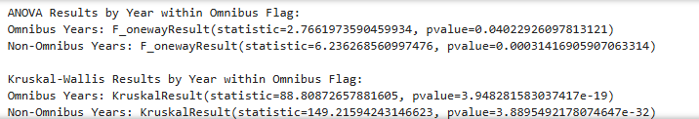
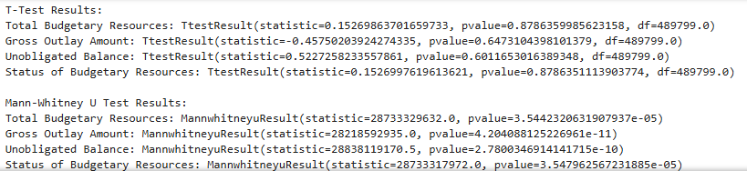
Results and Findings
Mann-Whitney U and ANOVA show significant spending differences Correlation analysis reveals strong associations during Omnibus years
Notes:
The results revealed significant differences in federal spending between Omnibus and non-Omnibus years, with tests like Mann-Whitney U and ANOVA showing statistically meaningful variations. Correlation analyses demonstrated substantial associations among budgetary resources, gross outlays, and unobligated balances during Omnibus years, suggesting that Omnibus bills drive higher spending across various categories.

Slide 7
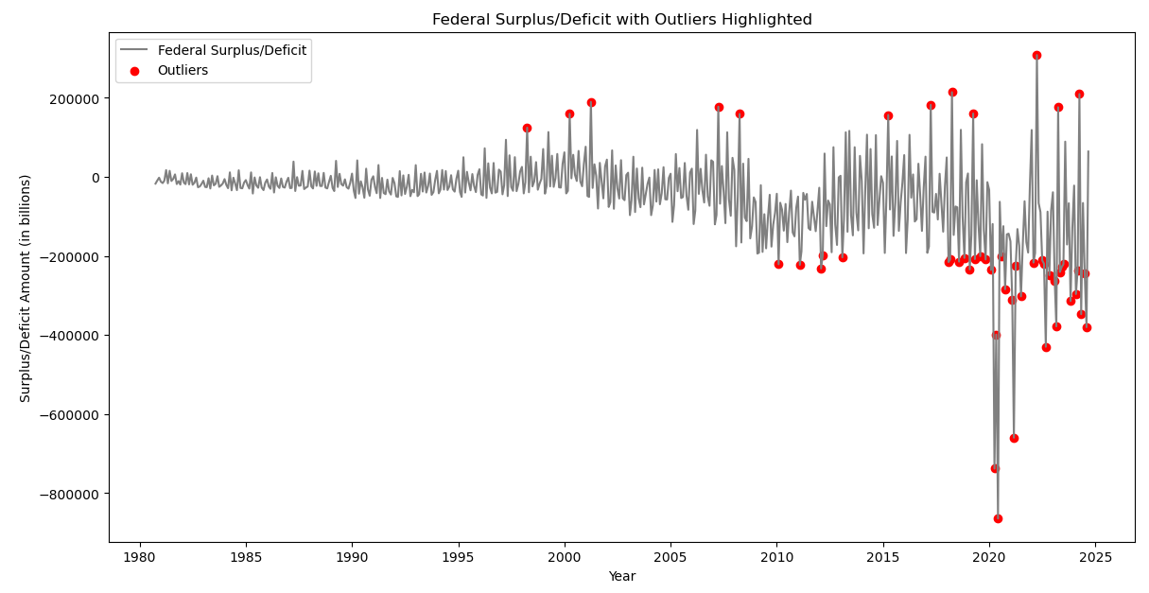
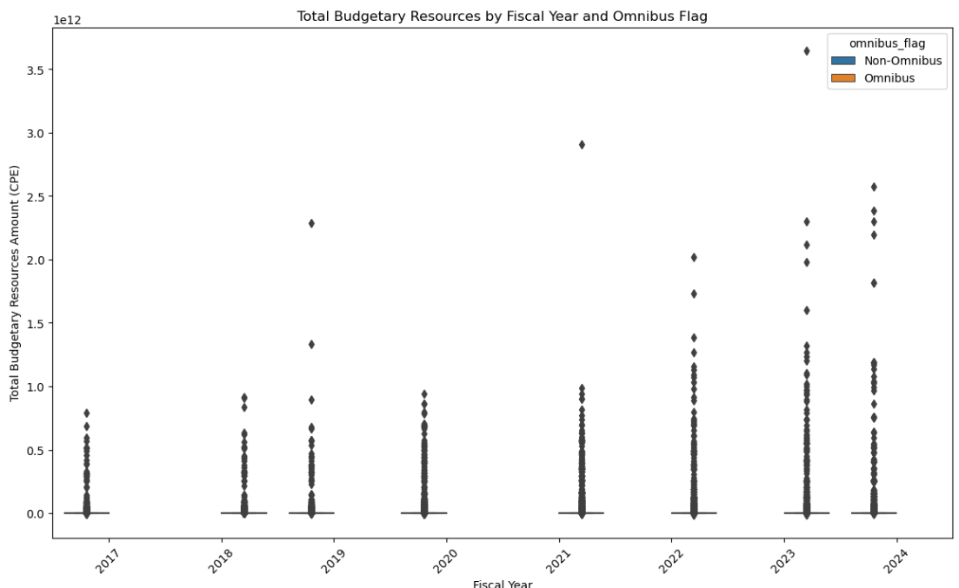
Statistical Analysis Summary
Non-parametric tests confirm Omnibus vs. non-Omnibus differences Strong correlations between budget resources and spending
Notes:
To summarize the statistical analysis, non-parametric tests confirmed that Omnibus years exhibit significantly different spending patterns. Correlation tests showed strong relationships between budget resources and expenditure statuses, indicating that Omnibus bills may contribute to excessive spending in key areas.

Slide 8

Blockchain and Big Data Model
Blockchain: Immutable ledger for transparency and security Big Data: Real-time analytics for public spending insights
Notes:
To address the transparency gap in federal spending, this project proposes a model that incorporates blockchain and big data. Blockchain’s immutable ledger would provide a secure and transparent record of all government expenditures, while big data analytics could offer real-time insights, allowing the public to monitor spending trends. Together, these technologies have the potential to transform fiscal oversight.

Slide 9
Conclusion and Recommendations
Conclusion: Omnibus bills contribute to spending inefficiencies Recommendations: Blockchain-based oversight and single-issue bills
Notes:
This research contributes to the understanding of how the U.S. government’s reliance on Omnibus bills has exacerbated the national debt and explores how blockchain technology and big data analytics can introduce greater transparency and accountability into federal spending. While there are limitations and ethical concerns, the potential benefits of using blockchain for civilian oversight of government spending are promising. Ultimately, the adoption of single-issue spending bills, supported by transparent technologies, is critical to ensuring that government spending aligns with public interests while maintaining fiscal responsibility. The findings suggest that a more transparent budgeting process, empowered by technology, could significantly reduce inefficiencies and overspending, helping the U.S. manage its growing national debt more effectively.

Slide 10
Future Research and Limitations
Limitations: Data inconsistencies, computational challenges, privacy concerns Future Research: Expand variables, refine blockchain model
Notes:
This study faced some limitations, including data inconsistencies, computational demands, and privacy issues inherent in handling government datasets. Future research could explore more fiscal variables and refine the blockchain oversight model to ensure comprehensive transparency in public spending.

Slide 11
References
Chen, H., & Zhang, Y. (2018). Big data analytics for improved public sector governance and transparency. Journal of Government Financial Management, 68(1), 10-17. https://doi.org/10.1234/jgovm.2018.68.1.001
Congressional Budget Office. (2023). The 2023 Long-Term Budget Outlook. Congressional Budget Office.
Federal Reserve Bank of St. Louis. (n.d.). FRED economic data. https://fred.stlouisfed.org/
GitHub Repository: Dunn, J. E. (2024). Capstone Project: U.S. Federal Spending Analysis and Transparency [GitHub repository]. GitHub. https://github.com/justandunn/MIS581-Capstone.git
Henning, C. R., & Kessler, M. (2020). The political economy of omnibus bills in Congress. Public Choice, 184(3), 357-376. https://doi.org/10.1007/s11127-020-00839-7
Polonsky, M. J., & Waller, D. S. (2018). Designing and managing a research project: A business student’s guide (3rd ed.). SAGE Publications, Incorporated.
Tripathi, G., Ahad, M. A., & Casalino, G. (2023). A comprehensive review of blockchain technology: Underlying principles and historical background with future challenges. Decision Analytics Journal, 9, 100344. https://doi.org/10.1016/j.dajour.2023.100344
USAspending.gov. (n.d.). USAspending. https://www.usaspending.gov/
Notes:
Finally, here is a list of sources referenced throughout my research. These sources provide the academic foundation and support for the methodologies and recommendations I’ve presented today.

